Slide 1


UNIT 1: Time for school
All about my class

Slide 2
Look at the photo gallery What are you good at (Learn more).
What / Who is in the picture?
How much do you know about your class?
Who is good at music / dancing / English…?
https://www.e-sfera.hr/dodatni-digitalni-sadrzaji/ae7e621a-465a-4e6d-8a5f-416323ec6983/
Click on the following link and match. Who do these organizations help?
https://learningapps.org/watch?v=pqe9x93d318
Can you name any similar organizations?

Slide 3
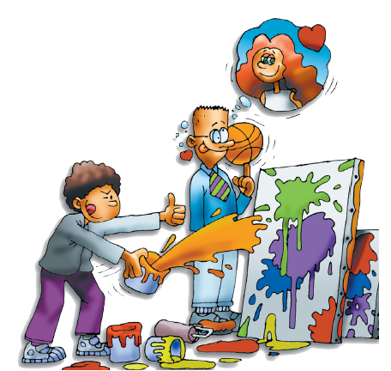

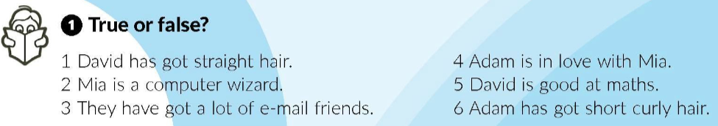
Listen to David talking about his class. Answer the question:
What is the name of the club they are members of?
Green Planet Club
Listen to David again. Are the sentences true (T) or false (F)?
F
T
F
F
T
F

Slide 4
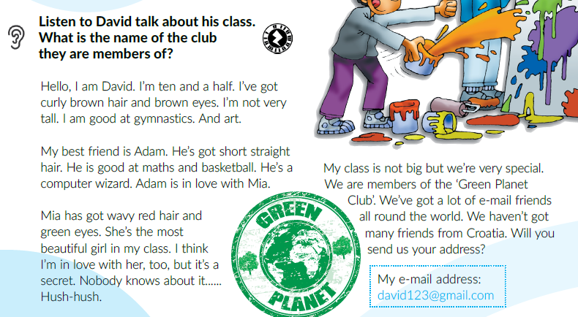
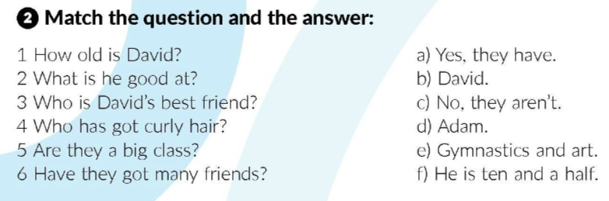
Read the text and match the question and the answer.
f
e
d
b
c
a

Slide 5
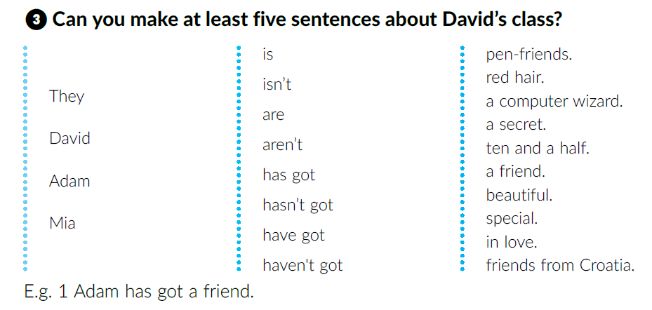
Use the information from the chart and describe David’s class.

Slide 6
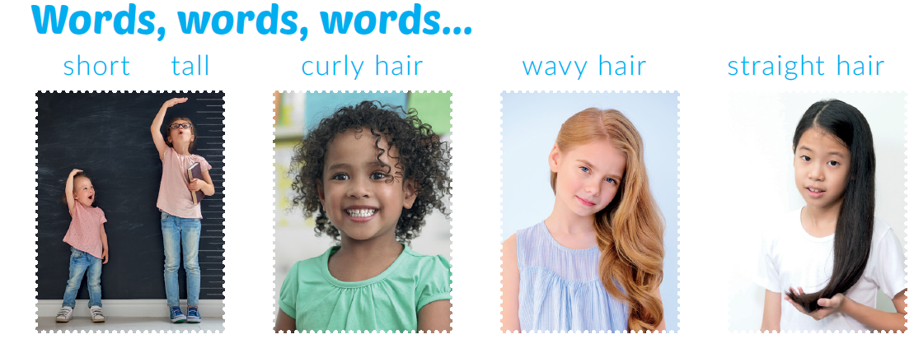
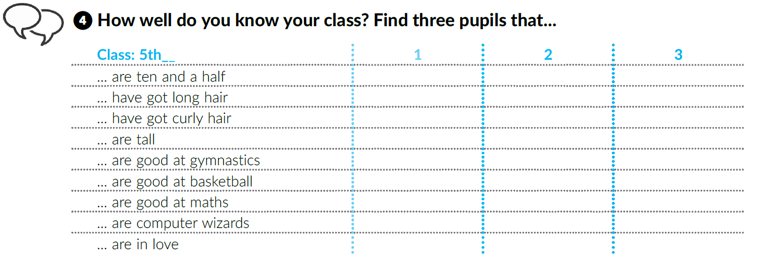
What do these words mean?
Fill in the table. You can work in groups if you want.
Use the information from the chart and talk about your classmates.

Slide 7
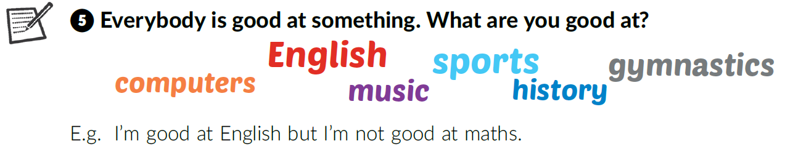
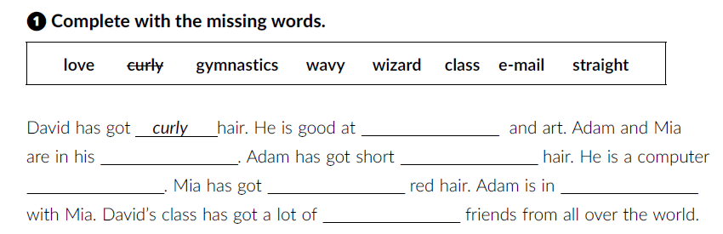
Work in groups. Make sentences as in the example.
Open your workbook at page 7.
gymnastics
class
straight
wizard
wavy
love
e-mail

Slide 8
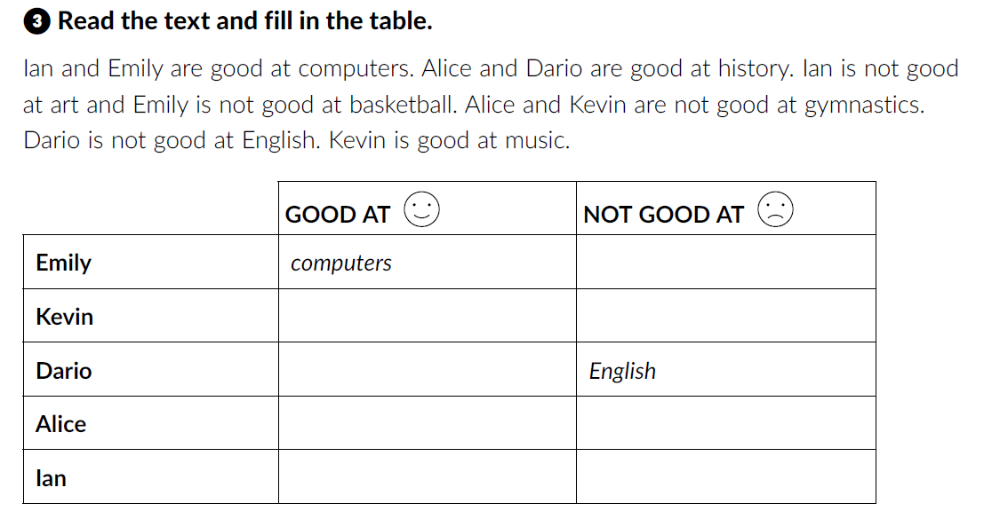
Open page 8 in your workbook.
basketball
music
gymnastics
history
history
gymnastics
computers
art

Slide 9
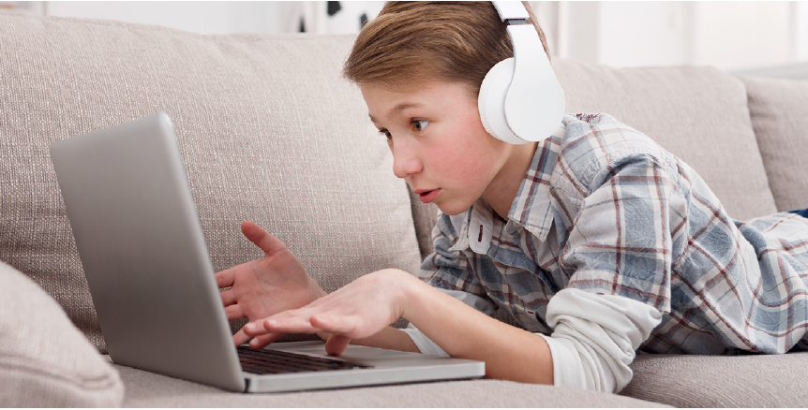
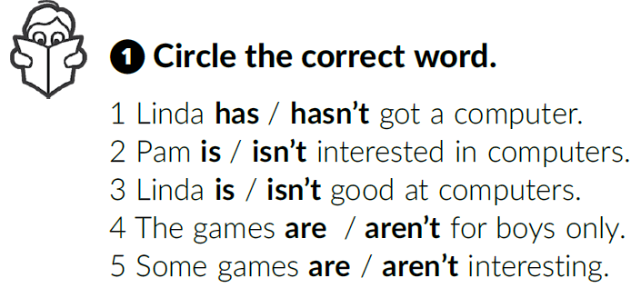
Are you a computer wizard?
How much time do you spend in front of your computer / laptop / tablet?
Are there any bad points of using too much technology?
What about our health?
Do you like computer games?
Do you have to share your computer with anyone?
Open your book at page 18.
Listen and circle the correct word.

Slide 10
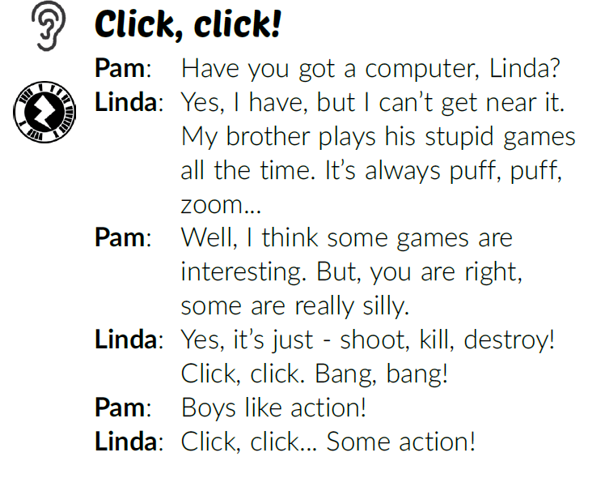
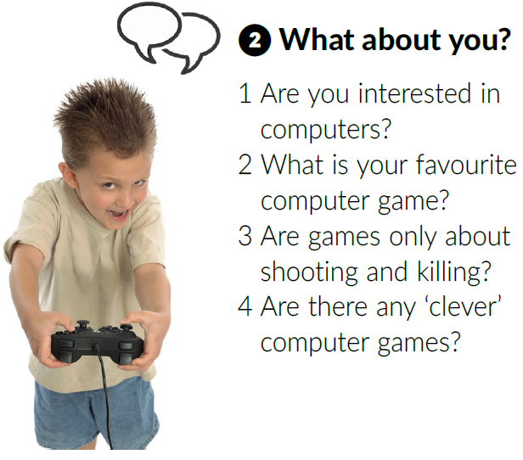
Work in pairs. Read the text out loud.
Ask and answer the questions.

Slide 11
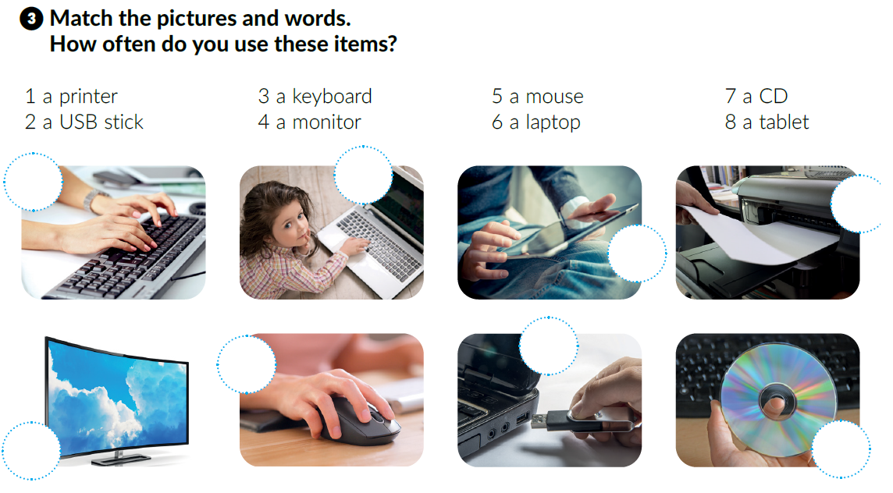
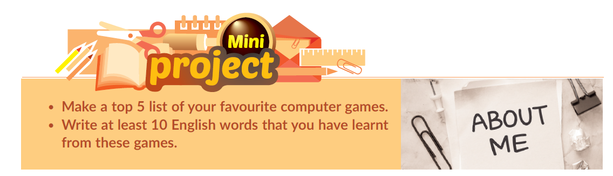
Do task 3.
Mini project time
3
6
1
How often do you use these items?
What do you use them for?
8
5
2
4
7

Slide 12
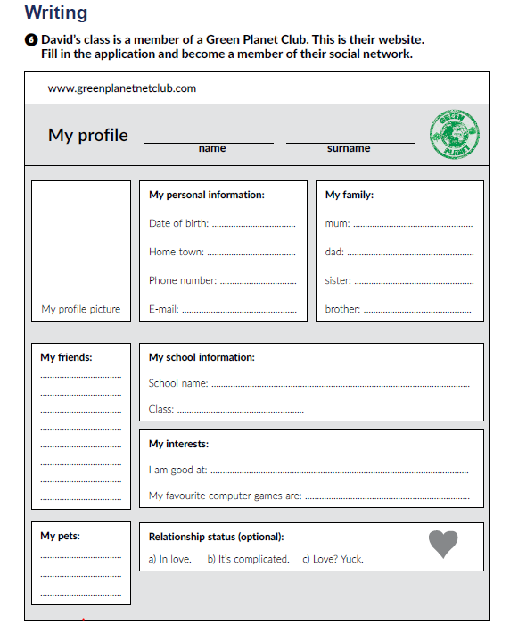
Are you a member of a social network?
What are the good and bad points of social media?
Open your workbook at page 9.
Fill in the application and become a member of the social network.

Slide 13
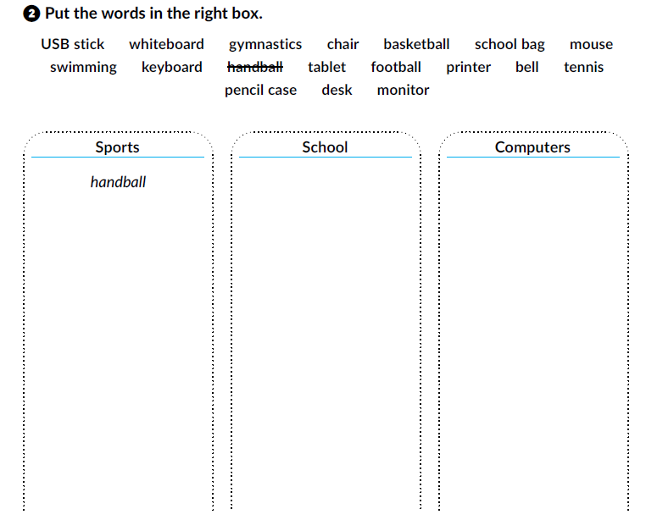
Open your workbook at page 8.
gymnastics
basketball
swimming
football
tennis
whiteboard
chair
school bag
bell
pencil case
desk
USB stick
mouse
keyboard
tablet
printer
desk

Slide 14

Click on the following link and choose ‘‘Self check”. Complete the task.
https://www.e-sfera.hr/dodatni-digitalni-sadrzaji/ae7e621a-465a-4e6d-8a5f-416323ec6983/
Click on the following link and choose ‘‘Learn more”. Read the text Three famous games and answer the questions.
https://www.e-sfera.hr/dodatni-digitalni-sadrzaji/ae7e621a-465a-4e6d-8a5f-416323ec6983/

Slide 15

What do you think of when you hear the word games?
fun
friends
play
Games
lose
computers,…
Let’s play Simon says. Listen to the commands and act them out.
Work in pairs.

Slide 16
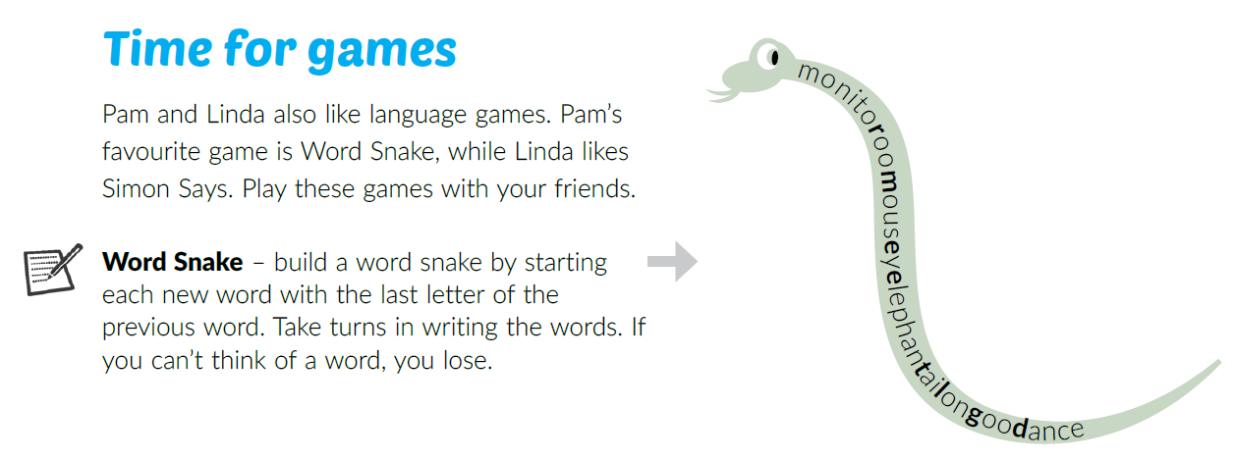
Work in groups.

Slide 17
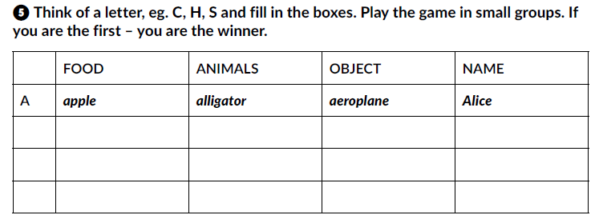
Open your workbook at page 8. Play Same-letter: Food, Animal, Object and Name.
Click on the following link and choose ‘‘Play and learn”. Revise what you have learnt by playing the games.
https://www.e-sfera.hr/dodatni-digitalni-sadrzaji/ae7e621a-465a-4e6d-8a5f-416323ec6983/

